Slide 1
Fish market - Machine Learning(Linear Regression)
OMKARAIAH
PGDA25

Slide 2
The data contains the following columns:
Species :-species name of fish
Weight :-weight of fish in Gram g
Length1 :- vertical length in cm
Length2 :-diagonal length in cm
Length3 :-cross length in cm
Height :- height in cm

Slide 3
df.describe()
 | Weight | Length1 | Length2 | Length3 | Height | Width | predict | residuals
count | 155.000000 | 155.000000 | 155.000000 | 155.000000 | 155.000000 | 155.000000 | 155.000000 | 1.550000e+02
mean | 369.573548 | 25.485806 | 27.604516 | 30.383226 | 8.939934 | 4.358886 | 369.573548 | -1.140261e-12
std | 312.685376 | 8.897865 | 9.555969 | 10.468442 | 4.336074 | 1.664295 | 295.568086 | 1.020375e+02
min | 0.000000 | 7.500000 | 8.400000 | 8.800000 | 1.728400 | 1.047600 | -227.799524 | -2.142226e+02
25% | 120.000000 | 19.000000 | 21.000000 | 22.950000 | 5.926950 | 3.363600 | 180.677304 | -7.279162e+01
50% | 270.000000 | 25.000000 | 26.500000 | 29.200000 | 7.615600 | 4.239000 | 351.067321 | -3.511632e+01
75% | 605.000000 | 32.000000 | 35.000000 | 39.350000 | 12.379300 | 5.373200 | 607.725269 | 6.326958e+01
max | 1100.000000 | 48.300000 | 51.700000 | 55.100000 | 18.957000 | 8.142000 | 931.132366 | 2.902806e+02

Slide 4
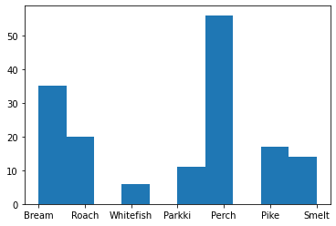
df['Species'].value_counts() plt.hist(df.Species)
Perch 56
Bream 35
Roach 20
Pike 17
smelt 14
Parkki 11
Whitefish 6
Name: Species, dtype: int64

Slide 5
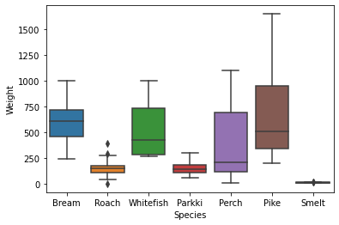
Boxplot of X = Species .Y = Weights

Slide 6
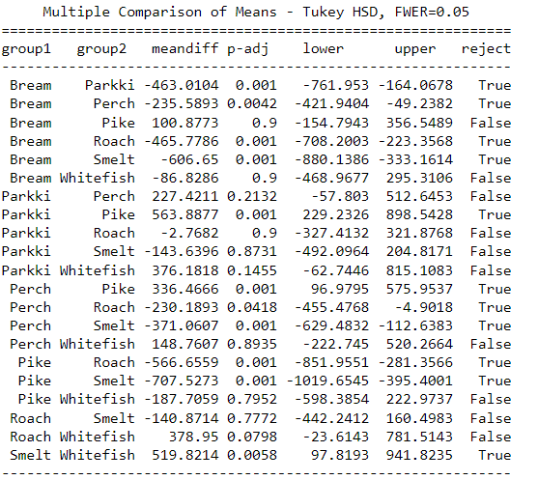
tukey = pairwise_tukeyhsd(df.Weight,df.Species, alpha=0.05) print(tukey)

Slide 7
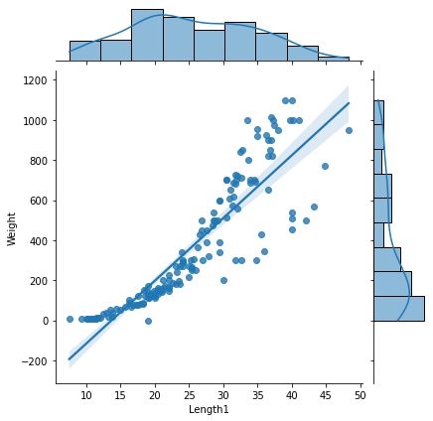
Jointplot of x='Length1',y='Weight'

Slide 8
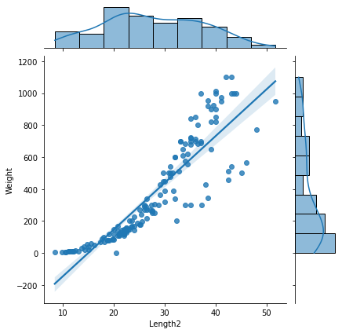
Jointplot of x='Length2',y='Weight'

Slide 9
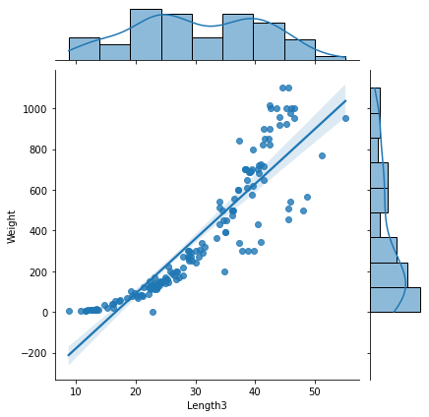
Jointplot of x='Length3',y='Weight

Slide 10
CORRELATION:-
 | Weight | Length1 | Length2 | Length3 | Height | Width
Weight | 1.000000 | 0.890173 | 0.894415 | 0.902576 | 0.815237 | 0.925664
Length1 | 0.890173 | 1.000000 | 0.999385 | 0.990205 | 0.688050 | 0.891260
Length2 | 0.894415 | 0.999385 | 1.000000 | 0.992765 | 0.704041 | 0.897855
Length3 | 0.902576 | 0.990205 | 0.992765 | 1.000000 | 0.768038 | 0.898315
Height | 0.815237 | 0.688050 | 0.704041 | 0.768038 | 1.000000 | 0.803268
Width | 0.925664 | 0.891260 | 0.897855 | 0.898315 | 0.803268 | 1.000000

Slide 11
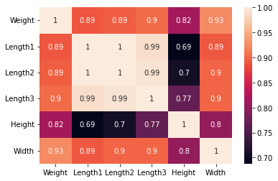
sns.heatmap(corr,annot=True)

Slide 12
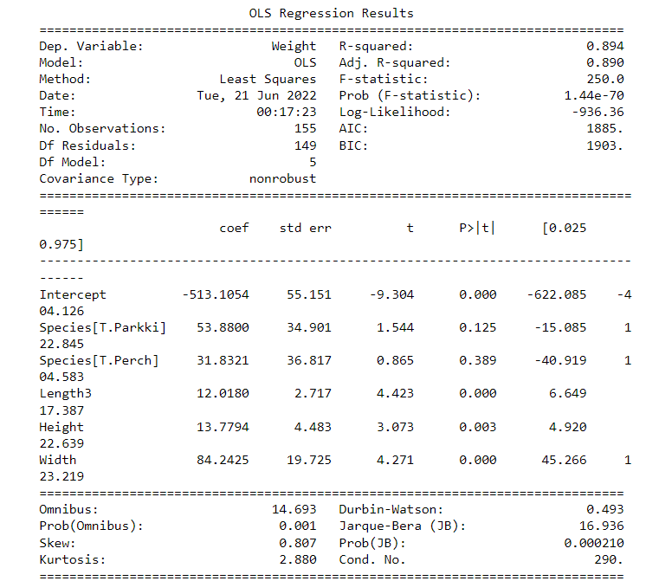
OLS Regression results

Slide 13
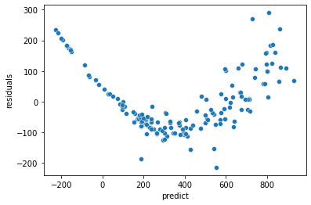
Scatterplot of x='predict',y='residuals’

Slide 14
Thank you

